Slide 1

MiniProject(19AI701) – Review2
Cloud-Enhanced Automatic Public Street Light System for Sustainable Urban Illumination
Submitted by:
BOOBESH PM-(212222233001)
GIFTSON RAJARATHINAM-(212222233002)
JEEVANESH-(212222233002)
2022-2026 Batch
TEAM NO: 216
Under the guidance of:
Dr.Lavanya G
Asst.Professor,Department of AIDS
DEPARTMENT OF COMPUTER SCIENCE AND ENGINEERING
SAVEETHA ENGINEERING COLLEGE
(Autonomous Institution – UGC, Govt. of India)
(Affiliated to Anna University, Approved by AICTE - Accredited by NBA & NAAC – ‘A’ Grade - ISO 9001:2015 Certified)
Saveetha Nagar, Thandalam, Chennai-602 105, TamilNadu, INDIA.

Slide 2
Agenda
Introduction
Statement of the Problem
Scope of the project
Methodology
Architectural Diagram
Flow
Algorithm used
Design - Use Case Diagram, Class Diagram
Implementation
Important code segments
Output, Results
Test Cases
Conclusions
Future work
References

Slide 3
Introduction
Real-time monitoring: Cloud-enhanced system uses sensors and microcontrollers to detect street light malfunctions.
Efficient issue identification: Centralized cloud storage and analysis enable quick identification of problems and streamlined maintenance.
Optimized performance: Smart technology improves street lighting efficiency, leading to energy savings and reduced waste.
Sustainability and reliability: Minimizes energy consumption, prevents failures, and supports sustainable urban development with reliable public lighting.

Slide 4
Statement of the Problem
Inefficient Maintenance: Traditional street lighting systems depend on manual inspections, causing delays in detecting malfunctions, extended downtime, and higher operational costs, which can compromise public safety.
Lack of Real-Time Monitoring: Without real-time monitoring, street light malfunctions are not addressed promptly, leading to prolonged periods of darkness and reduced operational efficiency.
Energy Waste: Automated street light management is lacking, resulting in unnecessary energy consumption as lights remain on longer than needed.
Environmental Impact: Increased energy waste from inefficient lighting systems contributes to higher energy usage and greater carbon emissions.

Slide 5
Scope of the project
Scope:
Improve the efficiency and reliability of public streets.
Utilize standard hardware and deep learning techniques
Design the system for flexible urban environments..
Target Audience: City Planners and Municipal Governments, Urban Development and Sustainability Professionals, Public Safety Agencies.
Deliverables:
A user-friendly interface for model deployment.
Documentation detailing the model's architecture, training process, and performance.

Slide 6
Scope of the project
Performance Prediction
Inclusions:
Leverages cloud technology, sensors, and microcontrollers to monitor street lights in real-time.
enabling swift issue detection and centralized data management for efficient maintenance.
Exclusions:
The project targets urban areas, excluding rural or suburban locations.
It does not involve other types of smart city technologies that are not directly related to street lighting (e.g., traffic management or waste management systems).

Slide 7
Methodology
Data Collection: Use a publicly available dataset containing number of streets and light planted .
Data Preprocessing: Convert the raw data into processed data and apply datas to cloud storage algorithms.
Model Selection: Choose able Hardware Architecture or create a custom model.
Training the Model: Split the dataset into training, validation, and test sets, and tune hyperparameters for optimal performance.
Model Evaluation: Assess the model's performance using accuracy, precision and recall on the test dataset.
Real-time Implementation: Integrate the cloud data system with street lights.
User Interface Development: Create a user-friendly interface displaying monitoring results and alerts.
Testing and Validation: Conduct field testing and gather user feedback to improve system effectiveness and usability.

Slide 8
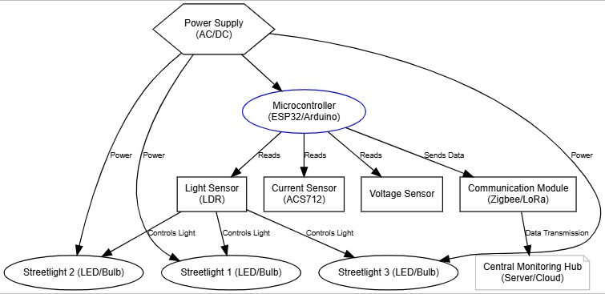
Architecture Diagram

Slide 9
Design-Use Case Diagram
Use case Diagram:A use case diagram is a graph of actors set of use cases enclosed by a system boundary, communication associations between the service providers and users and generalization among use cases.
The use case model defines the outside (service providers) and inside (use case) of the system’s behavior.
USER
UML DIAGRAMS
ADMIN

Slide 10
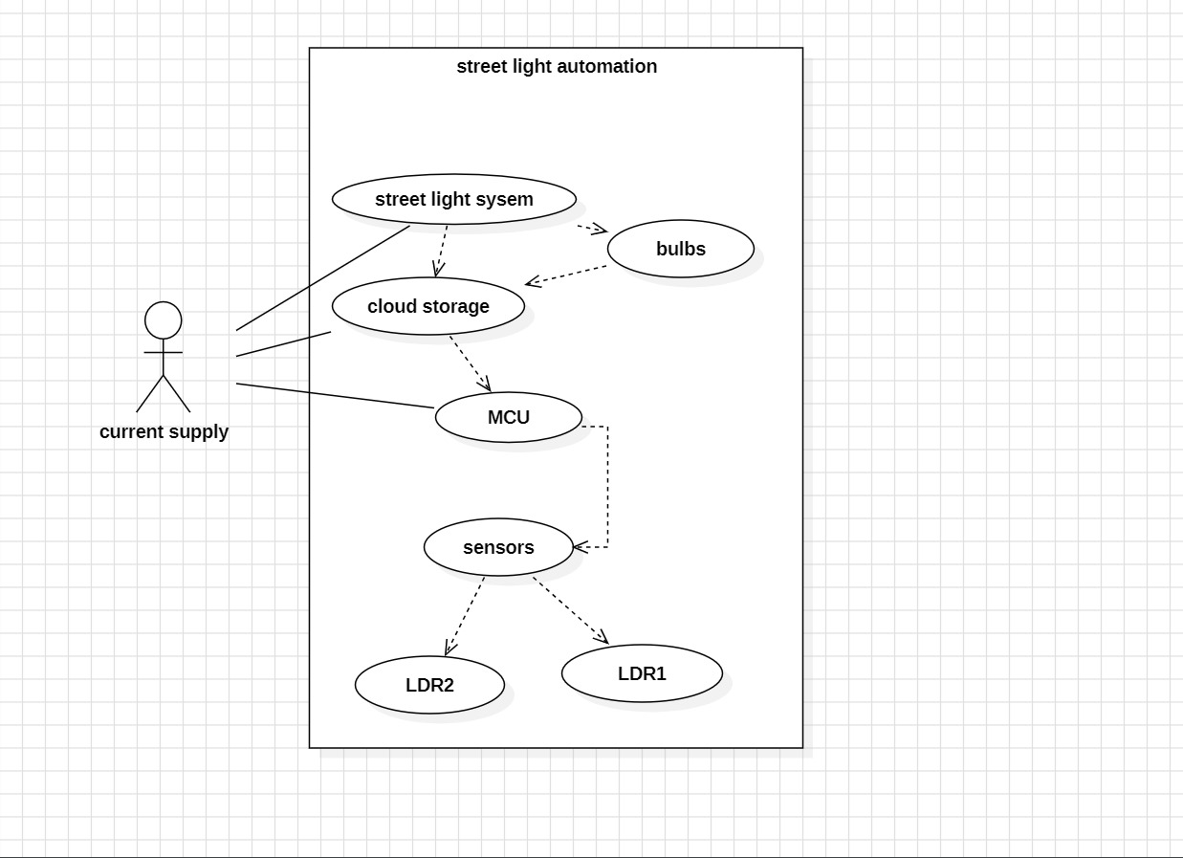
Design-Use Case Diagram

Slide 11
Design-Class Diagram
The class diagram for the Real-Time problem Detection System consists of several key classes. The central class, Problem Detection System, manages the core functions, including Defective light/Power Consumption etc..
It interacts with the cloud data, which handles streets count, and number of Lights and Watts.
These components work together to monitor drowsiness in real-time, ensuring safety and vigilance in critical scenarios.

Slide 12

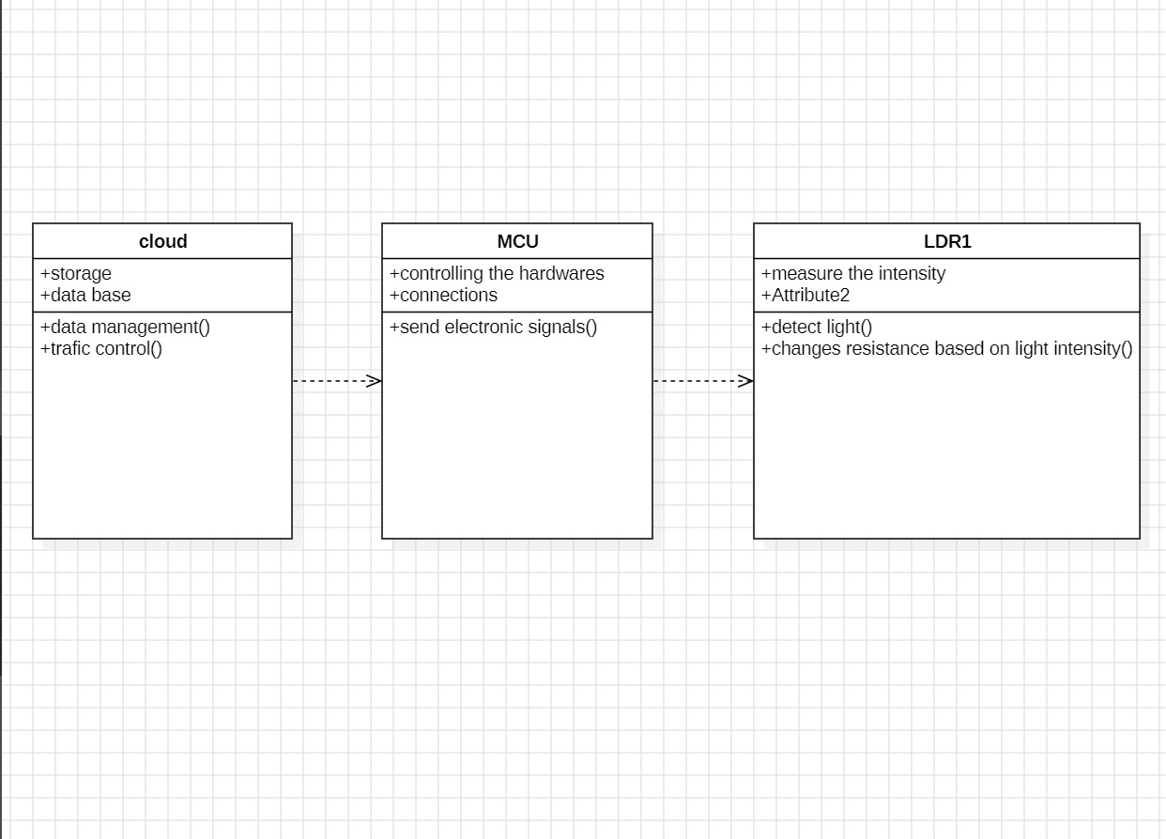
Design-Class Diagram

Slide 13
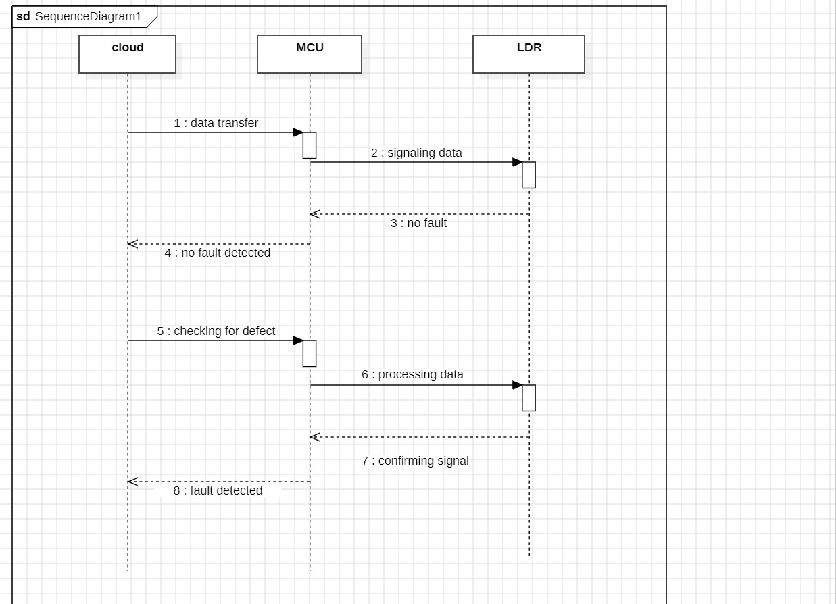
Sequence Diagram

Slide 14
Algorithms used
Light Automation:
The system continuously records real-time power consumption.
Defective unit Detection:
The system uses cloud data to detect the unit defective and recive the location in the database.
Data detection identifies the unit damaged, and The cloud isolates the location of the Damaged unit.
Preprocessing:
Raw data from sensors (e.g., streetlight status, malfunctions, environmental conditions) is cleaned to remove any noise or inaccuracies.
Feature Engineering Relevant features are extracted from raw sensor data, such as identifying patterns in streetlight malfunctions, environmental factors affecting performance, or usage patterns.

Slide 15
Hardware and software selection
Software Requirements:
Visual Studio Code
IDLE Python Compiler
Anaconda
Harware Requirements:
LDR
Aurdino
relay

Slide 16
Implementation
The setup includes a microcontroller, likely an ESP8266 or similar Wi-Fi-enabled board, connected to three relay modules and powered via USB.
Each relay module is responsible for controlling one light bulb, switching it on or off through the microcontroller.
The relays are wired to the digital output pins of the microcontroller, enabling individual control of each relay.
Each relay has three main connections: common (COM), normally open (NO), and normally closed (NC), with the circuit configured to control bulbs through the NO terminal.
The light bulbs light up when the relay triggers and completes the circuit, allowing current flow.
This setup is suitable for IoT smart lighting systems, with potential for remote or automated control, e.g., via platforms like Blynk.

Slide 17
Important Code segments
//define Authentications from blynk
#define BLYNK_TEMPLATE_ID "TMPL3BF-9rs0O"
#define BLYNK_TEMPLATE_NAME "Street light fault indicator"
#define BLYNK_AUTH_TOKEN "yiYslMz6K1LeqjQzAyUQDIKvxjxfZVGT"
#define BLYNK_PRINT Serial //library for blynk
#include <ESP8266WiFi.h> //library for
Wi-Fi Configure
#include <BlynkSimpleEsp8266.h> //library for
simple coding interface on blynk
// Connection Configuration
char auth[] = BLYNK_AUTH_TOKEN;
char ssid[] = "iotadmin"; //Enter
your WIFI name
char pass[] = "12345678"; //Enter your
WIFI password
BlynkTimer timer; //Timer function
#define r1 D5
#define r2 D6
#define r3 D7
int ldr1=0,ldr2=0,fault=0;

Slide 18
Important Code segments
//user defined function for send data to iot using timer
void sendSensor()
{
ldr1=analogRead(A0);
ldr2=digitalRead(D2);
if(ldr1>800){
digitalWrite(r1,LOW);
digitalWrite(r2,LOW);
digitalWrite(r3,LOW);
if(ldr2==1){
fault=1;
}
else{
fault=0;
}
}
else{
digitalWrite(r1,HIGH);
digitalWrite(r2,HIGH);
digitalWrite(r3,HIGH);
}
Serial.println(fault);
Blynk.virtualWrite(V0, fault) ;
}

Slide 19
Important Code segments
// Arduino setup function
void setup() {
Serial.begin(9600);
pinMode(r1,OUTPUT);
pinMode(r2,OUTPUT);
pinMode(r3,OUTPUT);
pinMode(D2,INPUT);
timer.setInterval(1L, sendSensor);
//Initialize Blynk function from library
Blynk.begin(auth, ssid, pass, "blynk.cloud", 80); //WiFi get
Connected here to Blynk cloud
}
//Arduino main funciton
void loop() {
Blynk.run(); //run blynk
instructions
timer.run(); //Timer
function runs looped here
}

Slide 20
Important Code segments
//function to split a string using character seperator
String getValue(String data, char separator, int index)
{
int found = 0;
int strIndex[] = { 0, -1 };
int maxIndex = data.length() - 1;
for (int i = 0; i <= maxIndex && found <= index; i++) {
if (data.charAt(i) == separator || i == maxIndex) {
found++;
strIndex[0] = strIndex[1] + 1;
strIndex[1] = (i == maxIndex) ? i+1 : i;
}
}
return found > index ? data.substring(strIndex[0], strIndex[1]) : "";
}

Slide 21
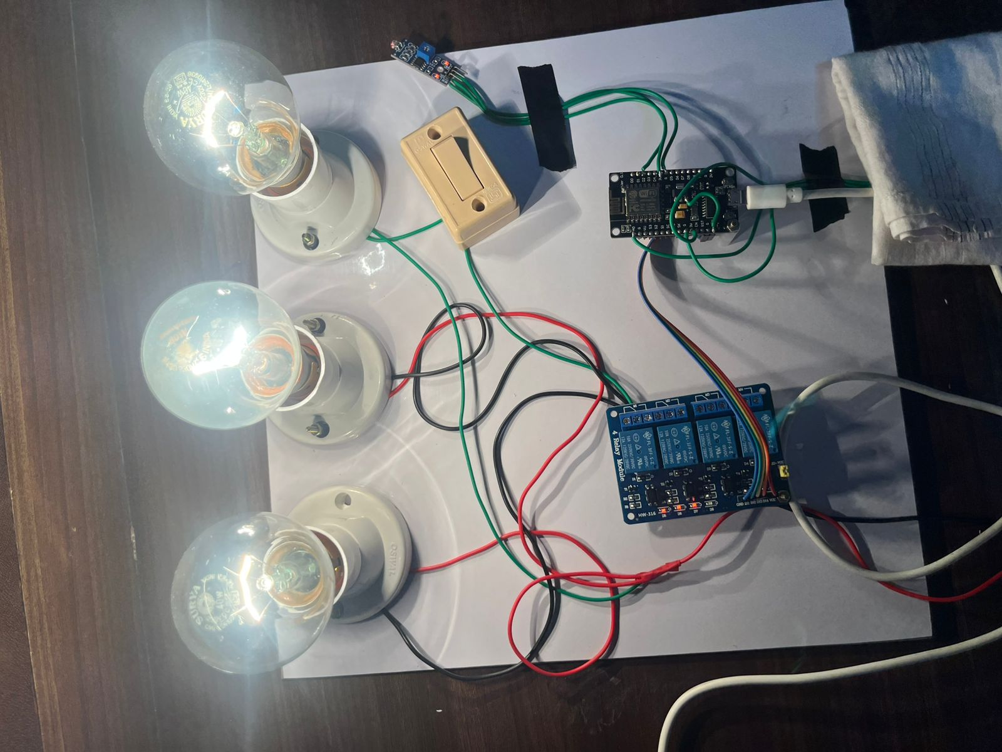
Output
OUTPUT:
All lights are on when sunlight intense is reduced (after sun set).

Slide 22
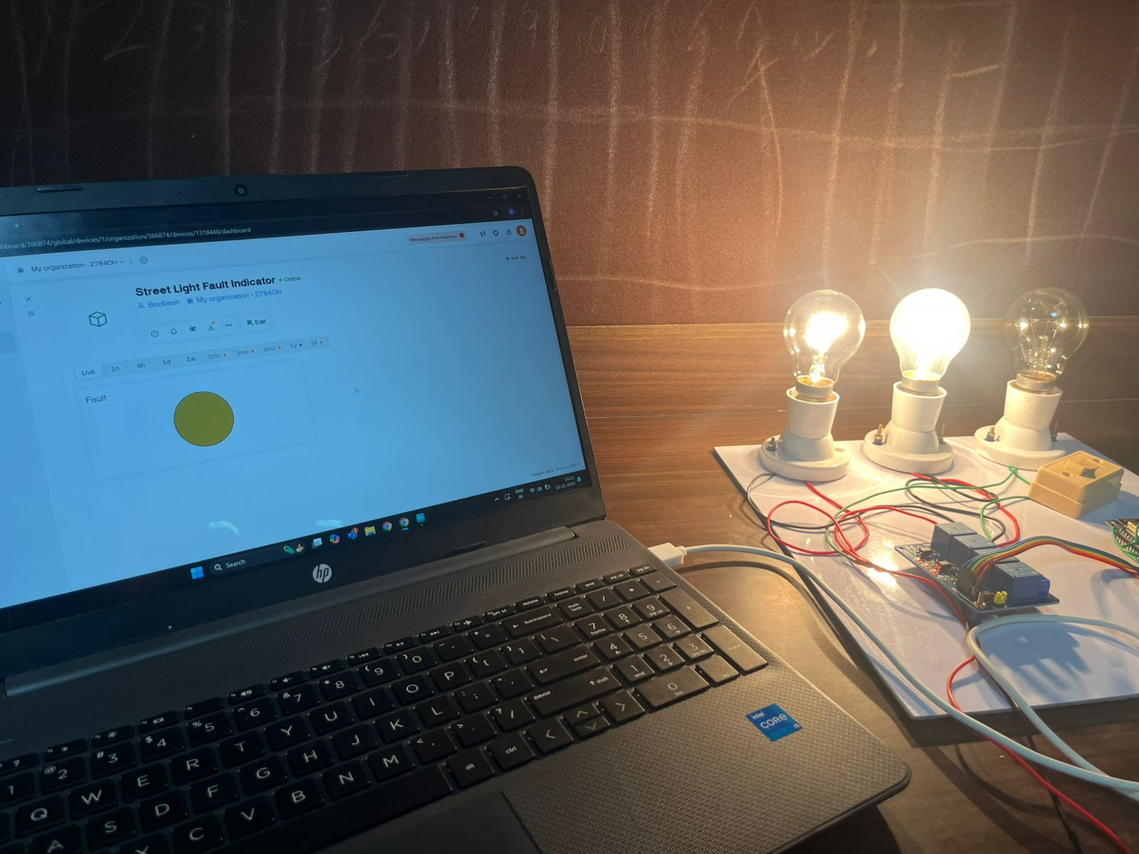
Output
OUTPUT:
Alerts when one light is off detected as defect.

Slide 23
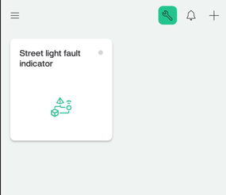
Output
OUTPUT:
LDR detects the light intensity level and notify through the blynk application

Slide 24
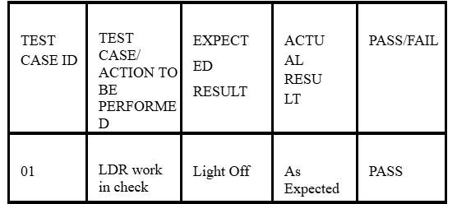
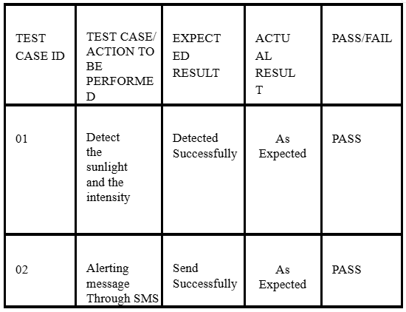
Test Cases
Test Cases

Slide 25
Results
Here are three key results from the project:
Energy Savings and Cost Reduction: The cloud-enhanced street light system achieved significant energy savings by optimizing lighting based on real-time data, resulting in lower maintenance costs and a more efficient use of resources.
Enhanced Public Safety and Sustainability: The system improved public safety by ensuring reliable street lighting and supporting sustainable urban development by minimizing energy consumption and reducing streetlight malfunctions.
Future Research Directions: Future development could focus on integrating the system with broader smart city infrastructure, exploring advanced machine learning algorithms for predictive maintenance, and addressing privacy and security concerns to enhance system performance and meet evolving urban challenges.

Slide 26
Conclusion
The project successfully implemented a cloud-enhanced automatic public street light system, showcasing the feasibility and effectiveness of utilizing IoT and cloud technologies for urban infrastructure management. This innovative system achieved significant energy savings, reduced maintenance costs, and enhanced public safety, highlighting the potential benefits of such solutions for sustainable urban development.
Looking ahead, future research and development could focus on integrating the system with other components of smart city infrastructure, exploring advanced machine learning algorithms for predictive maintenance, and addressing potential privacy and security concerns. These directions would further enhance the system's capabilities and ensure its alignment with emerging urban needs.

Slide 27
Future Work
Integration of AI and Predictive Maintenance: Future systems could incorporate artificial intelligence (AI) and machine learning algorithms to predict potential streetlight malfunctions before they occur. By analyzing historical data and sensor inputs, the system could forecast failures and trigger proactive maintenance, reducing downtime and operational costs.
Expansion of IoT Device Integration: To further enhance real-time monitoring and performance optimization, the system could integrate additional IoT sensors (e.g., environmental data like air quality, weather conditions, traffic patterns) to optimize streetlight behavior dynamically. This could improve energy savings, reduce light pollution, and enhance public safety based on real-time environmental conditions.

Slide 28
References
Ożadowicz and J. Grela, “Energy saving in the street lighting control system—a new approach based on the EN-15232 standard,” Energy Efficiency, 10(3), 2017, pp.563- 576.
S. M. Sorif, D. Saha and P. Dutta, "Smart Street Light Management System with Automatic Brightness Adjustment Using Bolt IoT Platform," 2021 IEEE International IOT, Electronics and Mechatronics Conference (IEMTRONICS), 2021, pp. 1-6, doi: 10.1109/IEMTRONICS52119.2021.9422668.
Badgaiyan, P. Sehgal, Smart street lighting system, international journal of science and research, vol. 4, 2015, pp. 271 – 274
Ouerhani, N. Pazos, M. Aeberli and M. Muller, "IoT-based dynamic street light control for smart cities use cases," 2016 International Symposium on Networks, Computers and Communications (ISNCC), 2016, pp. 1-5, doi: 10.1109/ISNCC.2016.7746112.
Pazos, M. Müller, M. Aeberli and N. Ouerhani, "ConnectOpen - automatic integration of IoT devices," 2015 IEEE 2nd World Forum on Internet of Things (WF-IoT), 2015, pp. 640-644, doi: 10.1109/WF-IoT.2015.7389129.
Twesigye, A. Ngenzi and E. Ndashimye, "An Embedded Fuzzy Logic Based Smart Street Lighting System," 2022 IEEE Nigeria 4th International Conference on Disruptive Technologies for Sustainable Development (NIGERCON), 2022, pp. 1-5, doi: 10.1109/NIGERCON54645.2022.9803089.

